Slide 1


Slide 2


Slide 3
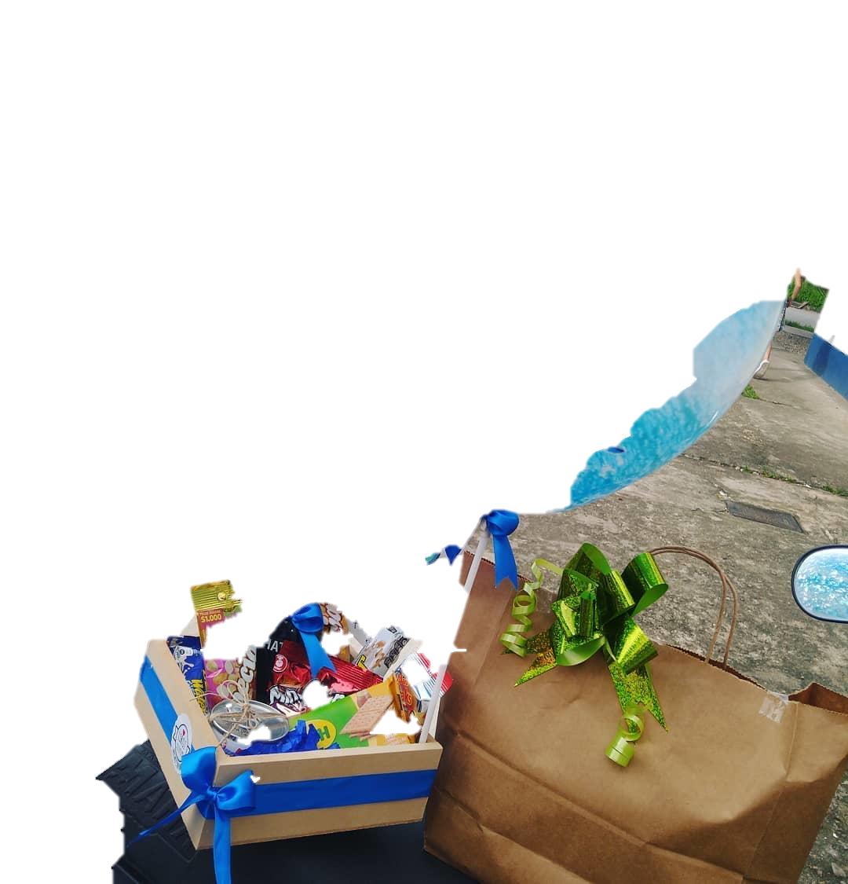
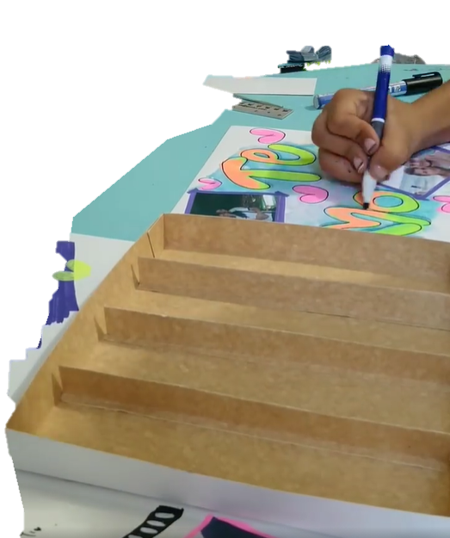

Slide 4



Sales System LIROZ
Sales System LIROZ

Slide 5



Sales System
LIROZ
Sales System
LIROZ
Sales System
LIROZ

Slide 6
Sales System
LIROZ
Sales System
LIROZ

Slide 7


